Slide 1
Controlling exposures to prevent occupational lung disease
in the construction industry
Do you breathe freely?
www.breathefreelyaustralia.org.au

Slide 2
Safe Work Australia report that workers in Australia are 8 times more likely to die from an occupational illness or disease than an accident at work.
Statistics released by Safe work Australia indicate that on average 250 people will die from injury at work, while over 2000 people will die from an occupational disease
Safe work Australia 2012
Notes:
Figures released here are overseas estimate that workers are far ore likely to die from occupational disease than from injury at work. However, figures in Australia are likely to be a gross underestimate. Much of our data is based on workers compensation data and many diseases are not attributed to work environments, because of the long latency between exposure and development of disease.

Slide 3
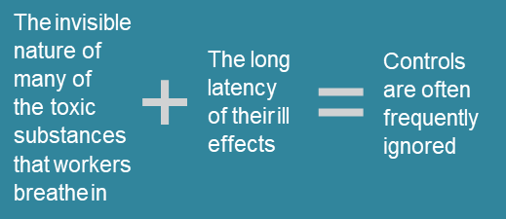
Treat health like safety and breathe freely
These statistics are startling and the recent emergence of accelerated silicosis in workers of engineered stone have highlighted the need for a preventative programs in Australia, focuses on occupational disease.
What isn’t well understood, is that we can protect workers’ health from silica and other inhalable hazards, and therefore prevent occupational deaths through good occupational hygiene practice.
This means by:
recognising the hazards
evaluating the risks, and
controlling exposures.
People at work (both employers and employees) need to recognise the hazards in the workplace , properly understand the real risks, then control their exposures to them.

Slide 4
That’s where Occupational Hygienists come in!
Occupational hygiene is the:
Anticipation
Recognition
Evaluation
Control, and
Confirmation of protection from …
…hazards at work that may result in injury, illness, or affect the well being of workers.
Occupational hygienists use their scientific knowledge, skills and experience to champion the protection of workers from the hazardous chemicals and other agents they have to work with.
“We want Australian workers to be able to go home safely at the end of each day to their family and friends”.

Slide 5
Breathe Freely Program
Aimed at promoting exposure control to prevent disease, Breathe Freely Australia is a combination of:
Web based resources:
Toolboxes
Checklists
Industry fact sheets
Case studies
Examples of best practice
Roadshows:
AIOH
Regulator
Industry
Controls
Best practice or case study

Slide 6
Breathe Freely Australia Engagement
Building on the Construction and Manufacturing themes developed by the BOHS to include:
Industry Themes
Mining
Engineered stone
Construction
Manufacturing
AIOH is engaging with
Government
Industry Groups
Employee based organisations
Other professional Bodies(RACP, AFOEM, TSANZ)
Charities(Lung foundation, Cancer council)
How you can help!!
Promote Breathe Freely Australia within your organisation
Contribute your expertise to the development of best practice documents for industry
Case studies
Networks

Slide 7
Contolling exposures to prevent occupational lung disease
in the construction industry
Breathe Freely Australia - helping you take control
.
Let’s get going by deciding to treat health like safety.
Then begin to breathe freely.
Join us and be part of the solution www.breathefreelyaustralia.org.au

